Slide 1
PRESENTATION PRODUCTION / SELECTED WORK
01
A clearer
point of view
Commercial proposals. Business evidence. Product stories.
Three studies in narrative, art direction
and editable delivery.
Independent studies. AI-assisted production with layout and content checks.
Notes:
Independent portfolio study. No commissioned work or business results are claimed.

Slide 2
PORTFOLIO / THREE DIFFERENT BRIEFS
02
The brief changes.
The discipline stays.
01
An agency proposal
Scope and commercial clarity
02
A retail briefing
Evidence and interpretation
03
Vela energy software
A fictional product narrative
Fictional proposals and product concepts. Published evidence in the retail briefing.
Notes:
Independent portfolio study. No commissioned work or business results are claimed.

Slide 3
01 / AGENCY PROPOSAL
03
A studio website,
with a defined scope
Five pages
Four weeks
Existing content and brand assets
Two design approval points
Fictional studio brief. Scope, schedule and quotation are illustrative.
Notes:
Fictional agency proposal. Assumptions: five pages, supplied content and brand assets, one language, an existing CMS, no commerce or booking engine. The schedule is a proposal, not an observed result.

Slide 4
01 / SCOPE
04
Five pages.
A specific job for each.
Home | Positioning, selected work and the next step
Services | Offer, deliverables and project fit
Work | Three supplied project stories
About | Studio background and working approach
Contact | Enquiry form and contact details
Included
Responsive layouts and an existing CMS
Fictional scope. The client supplies final content and an existing identity.
Notes:
Independent portfolio study. No commissioned work or business results are claimed.

Slide 5
01 / DELIVERY SCHEDULE
05
Each week has a delivery
and a decision
Week | Delivery | Client decision
01 | Page structure and visual direction | Approve direction
02 | Core page designs | Approve layouts
03 | CMS build and content entry | Review working site
04 | Responsive checks and handover | Accept for launch
Timing assumes complete content and feedback within two business days.
Notes:
Fictional four-week schedule. Design approvals at weeks one and two. Working-site review and acceptance follow in weeks three and four. Timing assumes complete material and feedback within two business days.

Slide 6
01 / COMMERCIAL TERMS
06
A price with
clear boundaries
€4,800
40% on booking
€1,920
60% before handover
Excluding applicable taxes
€2,880
One consolidated revision at each design approval.
Illustrative website quotation. This is not the presentation-production service price.
Notes:
Fictional website quote to show commercial hierarchy. EUR 4800 * 0.4 = EUR 1920; EUR 4800 * 0.6 = EUR 2880; together EUR 4800. This is not collected revenue or the fee of the presentation service. Changes to agreed scope are quoted separately.

Slide 7
02 / EUROPEAN RETAIL BRIEFING
07
Online shopping
in Europe
77%
of EU internet users
bought online in the
previous 12 months
A measure of participation. A starting point for market questions.
Eurostat, 20 February 2025. Historical 2024 survey, not current 2026 figures.
Notes:
Source: Eurostat, Online shopping in the EU keeps growing, 20 February 2025. https://ec.europa.eu/eurostat/web/products-eurostat-news/w/ddn-20250220-3. Internet users aged 16-74, online buying for personal use in the previous 12 months, survey year 2024. Published percentages are rounded. Independent study, not a Eurostat commission.

Slide 8
02 / SELECTED MARKETS
08
Online buying varies
sharply between markets
Source: Eurostat, 20 February 2025. Internet users aged 16–74. Selected countries, not a full ranking.
Notes:
Source: https://ec.europa.eu/eurostat/web/products-eurostat-news/w/ddn-20250220-3. Rounded published 2024 percentages: Ireland 96, Netherlands 94, Denmark 91, EU 77, Italy 60, Romania 60, Bulgaria 57. Denominator: internet users aged 16-74, personal purchases in previous 12 months. The selected countries are not a full ranking. EU is an aggregate, not their simple average. Native chart with literal workbook data.

Slide 9
02 / INTERPRETATION
09
Participation alone
does not decide a budget
What the evidence establishes
What the retailer still needs
How common online buying is
among internet users in each market.
Order value and gross margin.
Delivery and return costs.
Conversion in its own channel.
Editorial judgement. The source measures participation, not retailer profitability.
Notes:
Independent editorial interpretation of the limits of https://ec.europa.eu/eurostat/web/products-eurostat-news/w/ddn-20250220-3. No causal inference or market profitability claim. The listed commercial inputs are proposed questions, not observed data.

Slide 10
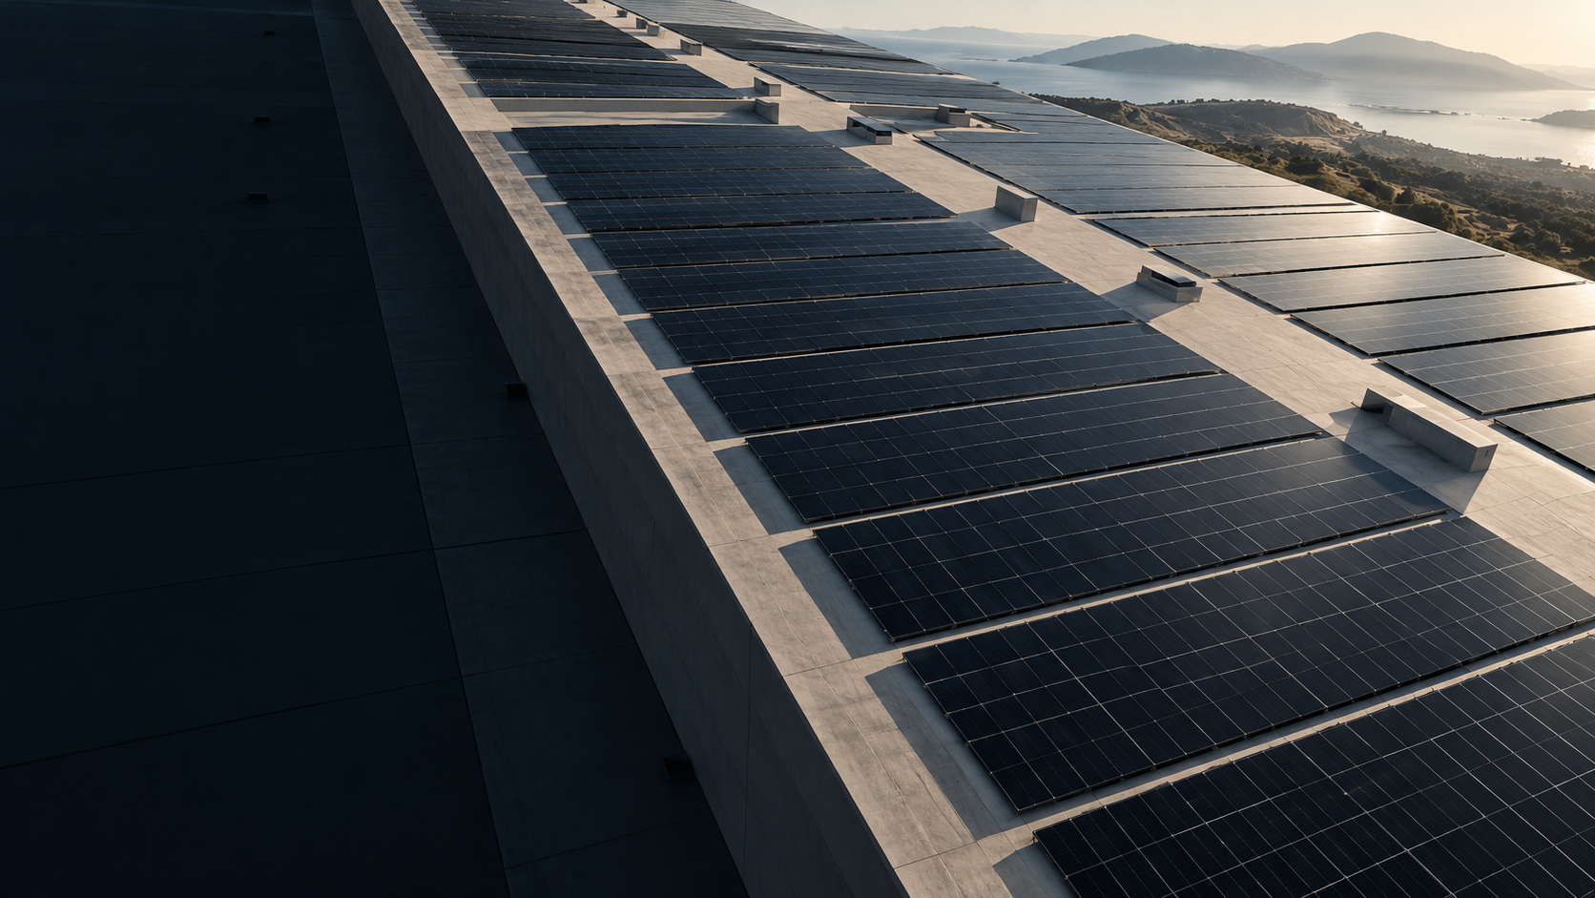
03 / VELA
10
Energy,
in context
A fictional software launch
for commercial energy operations
Independent product concept. Generated artwork. No real customer site.
Notes:
Vela is a fictional energy-software concept created for this portfolio. Product capabilities, implementation and customer demand are unvalidated. The image was generated with the built-in image tool, prompt: architectural editorial aerial of an industrial photovoltaic roof, dark left negative space, warm concrete, no real identifiable location. It is conceptual artwork, not evidence of a real site.

Slide 11
03 / THE PRODUCT QUESTION
11
One site.
Several energy decisions.
A solar forecast is one input.
Operating limits decide what can move.
The concept gives an operator a proposed schedule
and the assumptions behind it, before any action.
Fictional concept. Proposed product behaviour, not an existing system.
Notes:
Fictional narrative premise. No engineering claim, performance guarantee or real operator observation. The concept distinguishes proposed schedules from site-authorised actions. Technical feasibility would require expert assessment.

Slide 12
03 / OPERATING MODEL
12
The operating rules
come before the schedule
01
02
03
Site inputs
Proposed plan
Operator control
Load forecast
Solar forecast
Equipment limits
A timed schedule
Visible assumptions
Approval required
Accept or amend
Record the decision
Review the outcome
Proposed workflow for a fictional product. Operators approve actions and retain site control.
Notes:
Fictional product workflow presented as three plain text columns, not an implemented architecture or a working user interface. No hardware integration, engineering feasibility, economics or efficacy is implied.

Slide 13
03 / ILLUSTRATIVE SCHEDULE
13
The same energy.
A different schedule.
Average load per one-hour interval (kW)
360 kWh in each schedule. Assumes a flexible load within approved site limits.
Synthetic example. No savings or real operating performance are represented.
Notes:
All chart data are synthetic, designed to demonstrate an editable two-series comparison. Six one-hour intervals. Original load [40,60,100,80,40,40] kW and proposed [40,50,60,70,80,60] kW both sum to 360, so each uses 360 kWh across the shown intervals. Every schedule is imaginary. Assumes a load that can move within approved equipment and operating limits. No tariffs, savings, solar data or real performance results are represented. Native embedded workbook stores literal chart data.

Slide 14
03 / PROPOSED PILOT
14
One site establishes
the operating rules
Pilot question | Evidence to review
Can the load move? | Approved equipment limits and operating hours
Can the plan be trusted? | Forecast error and an auditable decision record
Who can authorise action? | Named operators and a documented override
Do the economics work? | Actual tariff, integration cost and measured usage
Fictional product proposal. Feasibility and commercial value remain unvalidated.
Notes:
Proposed evaluation questions for a fictional product pilot, not a conducted trial or engineering assessment. No buyers, market size, certifications, savings, customer proof or operating software is claimed.

Slide 15
PRESENTATION PRODUCTION / WORKING ARRANGEMENT
15
A considered story.
An editable handover.
PowerPoint and PDF
A written brief defines the audience, scope and decision.
One contact consolidates the feedback.
Entirely in writing. Supplier setup precedes paid work.
Independent portfolio. Agent-led AI-assisted production with layout and content checks.
Notes:
The studies show presentation production, not commissioned client work or business credentials. All communication is text-only with no face, voice, calls or interviews. Agent-led AI processing requires permission before confidential materials are shared. No paid project is accepted before supplier and payment readiness.

